Slide 1
LEE TAE HYUN 201921311 System Semiconductor Engineering University of Sangmyung
Toy Project
Summer 2023

Slide 2
Contents
DECODER
ENCODER
MUX
DEMUX
SR-FF
D-FF
JK-FF
T-FF
Shift Register
Binary COUNTER
Ring COUNTER
Johnson COUNTER
Gray COUNTER
Parity Check
RCA
CLA
Shift add multi
SUBSTRACTION

Slide 3
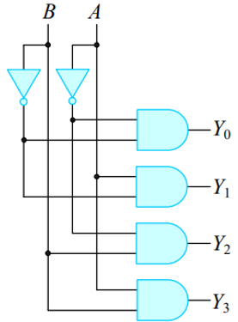
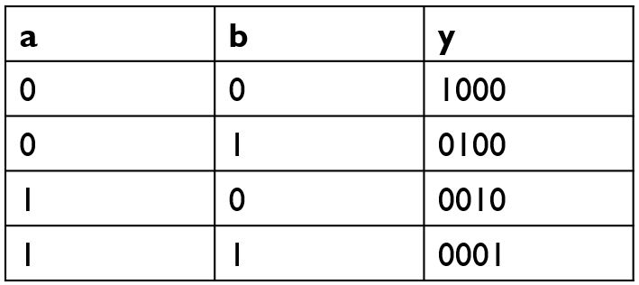
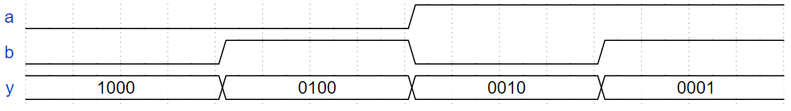
Decoder
Decoder
n비트의 2진 코드를 최대 2^n개의 서로 다른 정보로 바꿔주는 회로

Slide 4
Decoder
input : a, b output : y[3:0]
source
testbench
always @(*)begin
if(a == 1'b0 && b == 1'b0) begin
y = 4'b1000;
end
else if(a == 1'b0 && b == 1'b1) begin
y = 4'b0100;
end
else if(a == 1'b1 && b == 1'b0) begin
y = 4'b0010;
end
else if(a == 1'b1 && b == 1'b1) begin
y = 4'b0001;
end
else
y = 4'bxxxx;
end
endmodule
decoder u_decoder(
.a(a),
.b(b),
.y(y)
); initial begin
a = 1’b0; b = 1’b0;
#5 a = 1’b0; b = 1'b1;
#5 a = 1’b1; b = 1’b0;
#5 a = 1’b1; b = 1'b1;
#5 $stop;
end
endmodule

Slide 5

Decoder
wave

Slide 6
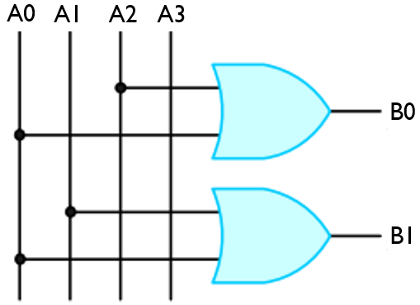
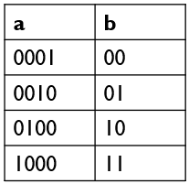
Encoder
Encoder
2^n개의 입력신호로부터 n개의 출력 신호를 만듦

Slide 7
Encoder
input : a[3:0] output : b[1:0]
source
testbench
always @(*)begin
if(a == 4'b0001) begin
b = 2'b00;
end
else if(a == 4'b0010) begin
b = 2'b01;
end
else if(a == 4'b0100) begin
b = 2'b10;
end
else if(a == 4'b1000) begin
b = 2'b11;
end
else b = 2'bxx;
end
encoder u_encoder(
.a(a),
.b(b)
);
initial begin
a = 4'b0001;
#5
a = 4'b0010;
#5
a = 4'b0100;
#5
a = 4'b1000;
#5
$stop;
end

Slide 8

Encoder
wave

Slide 9
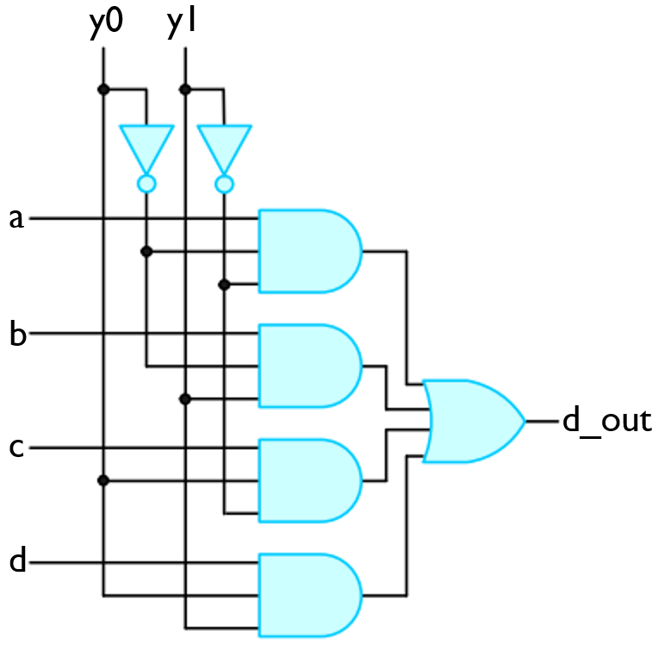
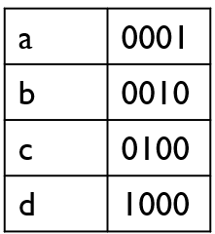
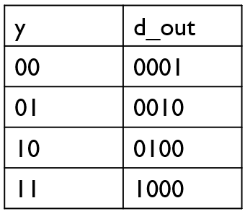
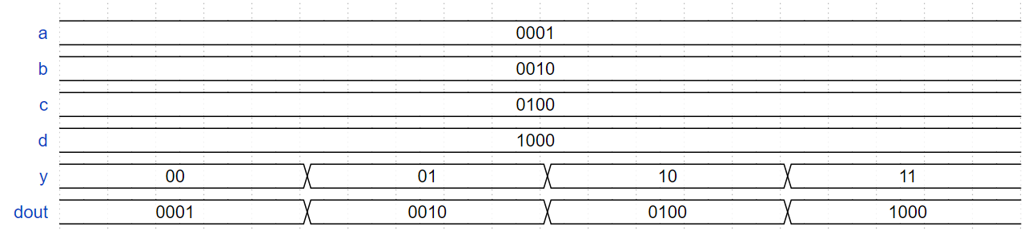
MUX
MUX
여러 개의 입력 선들 중에서 하나를 선택하여 출력선에 연결하는 회로

Slide 10
MUX
input : (a, b, c, d)[3:0], y[1:0] output : dout[3:0]
source
testbench
always @(*)begin
if(y == 2'b00) begin
dout = a;
end
else if(y == 2'b01) begin
dout = b;
end
else if(y == 2'b10) begin
dout = c;
end
else if(y == 2'b11) begin
dout = d;
end
else dout = 4'bxxxx;
end
initial begin
a = 4'b0001;
b = 4'b0010;
c = 4'b0100;
d = 4'b1000;
y = 2'b00;
#5
y = 2'b01;
#5
y = 2'b10;
#5
y = 2'b11;
#5
$stop;
end

Slide 11

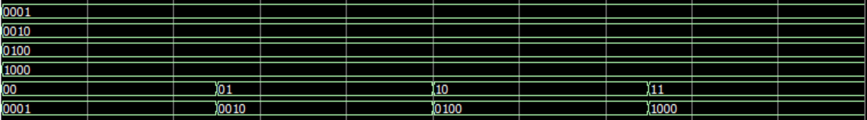
MUX
wave

Slide 12
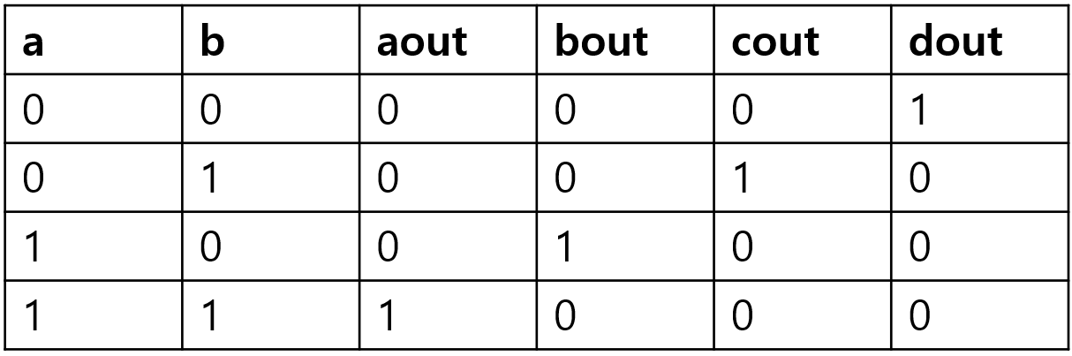
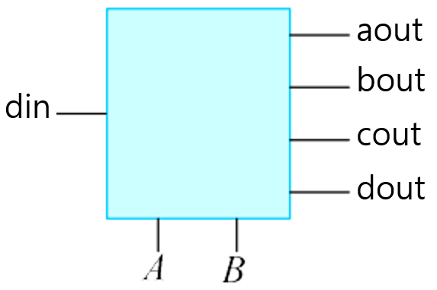
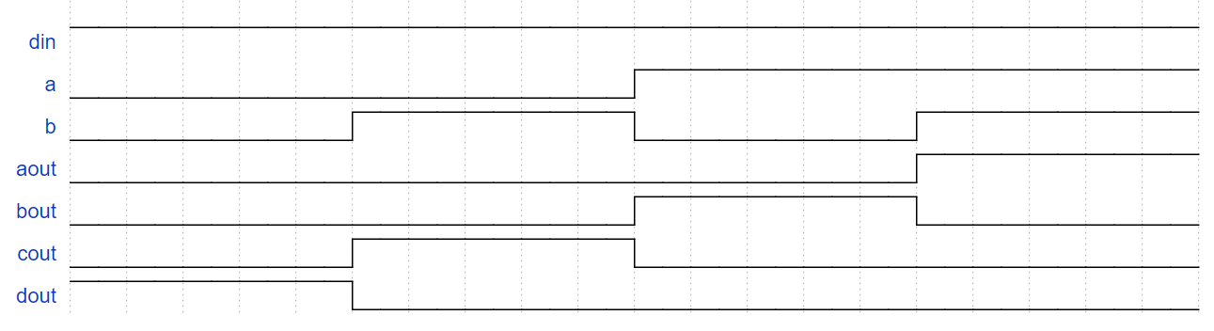
DEMUX
DEMUX
1개의 입력선을 여러 개의 가능한 출력선들 중 하나를 선택해서 연결하는 회로

Slide 13
DEMUX
input : din, a, b output : aout, bout, cout, dout
source
testbench
always @(*) begin
if(a == 1'b0 && b == 1'b0) begin
aout = 1’b0; bout = 1'b0;
cout = 1’b0; dout = 1'b1;
end
else if (a == 1'b0 && b == 1'b1) begin
aout = 1’b0; bout = 1'b0;
cout = 1’b1; dout = 1'b0;
end
else if (a == 1'b1 && b == 1'b0) begin
aout = 1’b0; bout = 1'b1;
cout = 1’b0; dout = 1'b0;
end
else if (a == 1'b1 && b == 1'b1) begin
aout = 1’b1; bout = 1'b0;
cout = 1’b0; dout = 1'b0;
end
end
initial begin
din = 1'b1;
a = 1'b0;
b = 1'b0;
#5
a = 1'b0;
b = 1'b1;
#5
a = 1'b1;
b = 1'b0;
#5
a = 1'b1;
b = 1'b1;
#5
$stop;
end

Slide 14

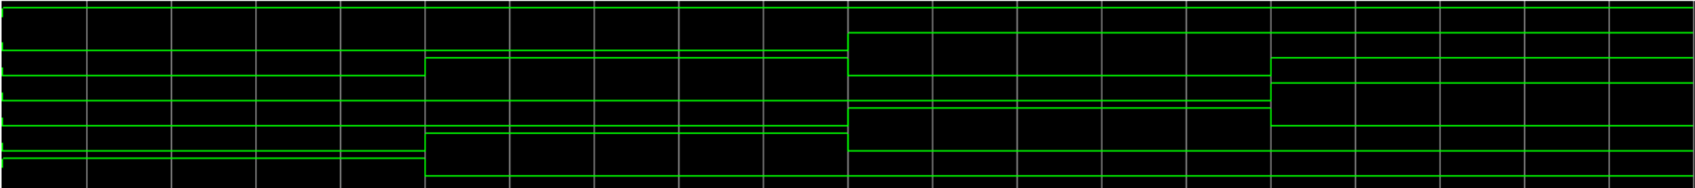
DEMUX
wave

Slide 15
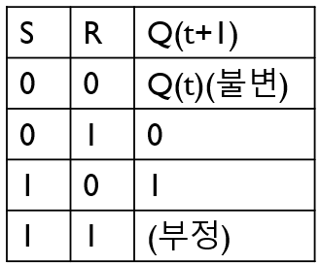
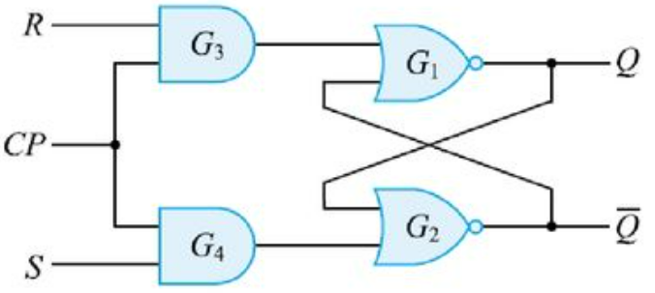
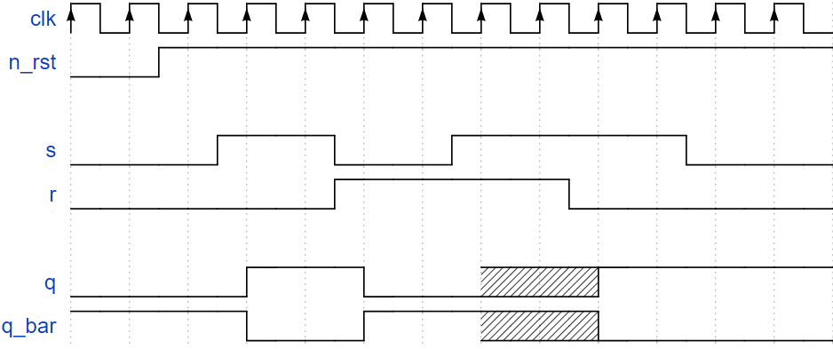
SR_FF
SR_FF
Cp가1이면 sr래치와 같은 동작을 수행, cp가 0이면 ff의 출력은 불변

Slide 16
SR_FF
input : clk, n_rst, s, r output : q, q_bar
source
testbench
assign q_bar = ~q;
always @(posedge clk or negedge n_rst)
begin
if(!n_rst)
q <= 1'b0;
else if (s == 1'b1 && r == 1'b0)
q <= 1'b1;
else if (s == 1'b0 && r == 1'b1)
q <= 1'b0;
else if (s == 1'b0 && r == 1'b0)
q <= q;
else
q <= 1'bx;
end
initial begin
clk = 1'b1;
n_rst = 1'b0;
end
always #(`T_CLK/2) clk = ~clk;
initial begin
s = 1'b0; r = 1'b0;
@(posedge clk);
n_rst = 1'b1;
@(negedge clk);
s = 1'b1; r = 1'b0;
@(negedge clk);
s = 1'b0; r = 1'b1;
@(negedge clk);
s = 1'b1; r = 1'b1;
@(negedge clk);
s = 1'b1; r = 1'b0;
@(negedge clk);
s = 1'b0; r = 1'b0;
@(negedge clk);
$stop;
end

Slide 17

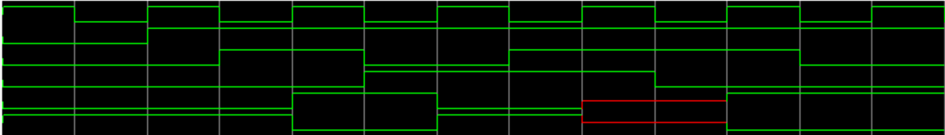
SR_FF
wave

Slide 18
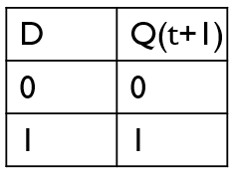
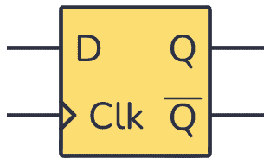
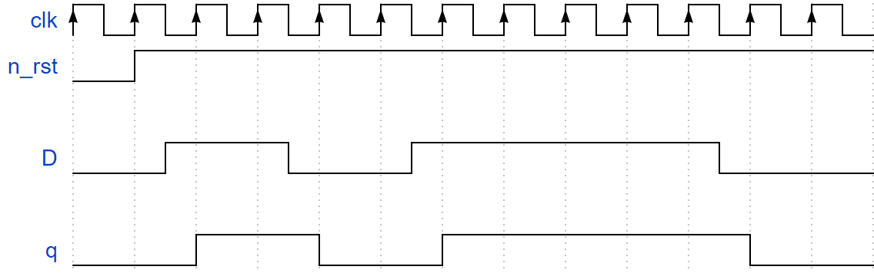
D_FF
D_FF
입력신호 D가 cp에 따라 그대로 출력에 전달되는 특성을 가지고 있음

Slide 19
D_FF
input : clk, n_rst, d output : q
source
testbench
always @(posedge clk or negedge n_rst)
begin
if(!n_rst)
q <= 1'b0;
else
q <= d;
end
initial begin
clk = 1'b1;
n_rst = 1'b0;
end always #(`T_CLK/2) clk = ~clk; initial begin
d = 1'b0;
@(posedge clk);
n_rst = 1'b1;
@(negedge clk);
d = 1'b1;
@(negedge clk);
d = 1'b0;
@(negedge clk);
d = 1'b1;
@(negedge clk);
@(negedge clk);
d = 1'b0;
@(negedge clk);
$stop;
end

Slide 20

D_FF
wave

Slide 21
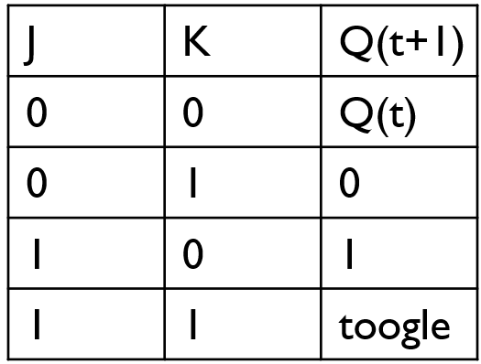
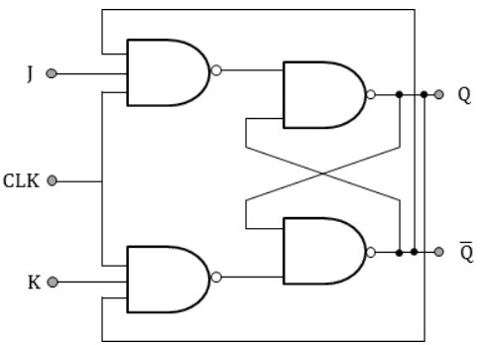
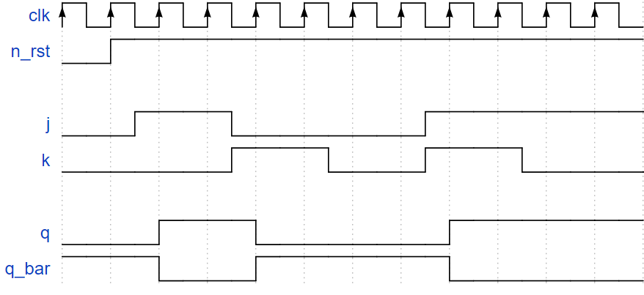
JK_FF
JK_FF
SR래치에서 S와 R이1일때 (부정)상태가 되는 문제점을 개선하여 S와 R이1일 때도 동작하도록 개선

Slide 22
JK_FF
input : clk, n_rst, j, k output : q, q_bar
source
testbench
assign q_bar = ~q;
always @(posedge clk or negedge n_rst)
begin
if(!n_rst)begin
q <= 1'b0;
end
else if (j == 1'b1 && k== 1'b0)
q <= 1'b1;
else if (j == 1'b0 && k== 1'b1)
q <= 1'b0;
else if (j == 1'b0 && k== 1'b0)
q <= q;
else if (j == 1'b1 && k== 1'b1)
q <= ~q;
else
q <= 1'b0;
end
initial begin
clk = 1'b1;
n_rst = 1'b0;
end always #(`T_CLK/2) clk = ~clk; initial begin
j = 1'b0; k = 1'b0;
@(posedge clk);
n_rst = 1'b1;
@(negedge clk);
j = 1'b1; k = 1'b0;
@(negedge clk);
j = 1'b0; k = 1'b1;
@(negedge clk);
j = 1'b0; k = 1'b0;
@(negedge clk);
j = 1'b1; k = 1'b1;
@(negedge clk);
j = 1'b1; k = 1'b0;
@(negedge clk);
$stop;
end

Slide 23

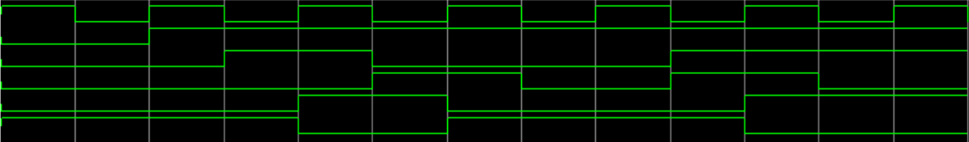
JK_FF
wave

Slide 24
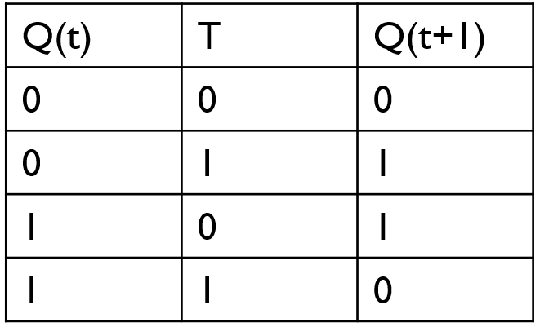
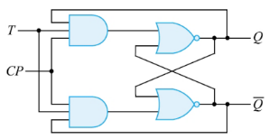
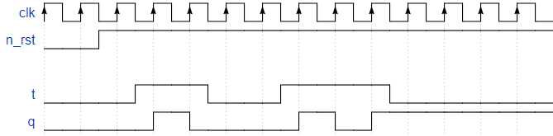
T_FF
T_FF
JK-FF의 입력을 묶어서 하나의 입력신호 T로 동작시키는 플립플롭

Slide 25
T_FF
input : clk, n_rst, t output : q
source
testbench
always @(posedge clk or negedge n_rst)
begin
if(!n_rst)
q <= 1'b0;
else if (t == 1'b1)
q <= ~q;
else
q <= q;
end
initial begin
clk = 1'b1;
n_rst = 1'b0;
end
always #(`T_CLK/2) clk = ~clk;
initial begin
t = 1'b0;
@(posedge clk);
n_rst = 1'b1;
@(negedge clk);
t = 1'b1;
@(negedge clk);
t = 1'b0;
@(negedge clk);
t = 1'b1;
@(negedge clk);
@(negedge clk);
t = 1'b0;
@(negedge clk);
$stop;
end

Slide 26

T_FF
wave

Slide 27
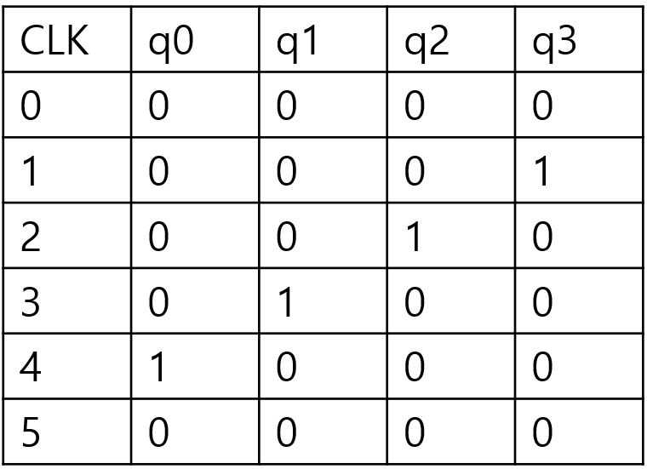
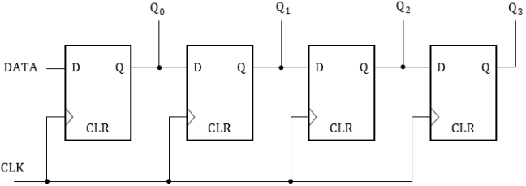
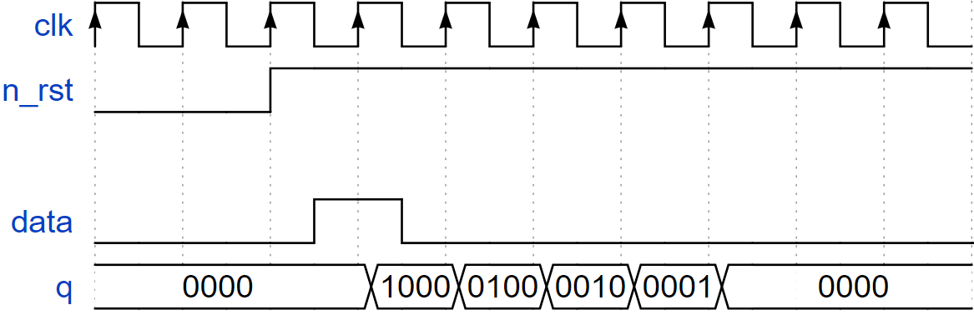
SHIFT REGISTER
SHIFT REGISTER
데이터를 저장하거나 데이터를 옆으로 이동할 때 사용되는 회로이다. (SIPO, SISO, PIPO, PISO가있다.)

Slide 28
SHIFT REGISTER
input : clk, n_rst, data output : q[3:0]
source
testbench
always @(posedge clk or negedge n_rst)
begin
if(!n_rst)
q <= 4'b0000;
else begin
q[3] <= data;
q[2] <= q[3];
q[1] <= q[2];
q[0] <= q[1];
end
end
initial begin
clk = 1'b1;
n_rst = 1'b0;
#(`T_CLK*2) n_rst = ~n_rst;
end
always #(`T_CLK/2) clk = ~clk;
initial begin
data = 1'b0;
wait(n_rst==1'b1);
#(`T_CLK*0.5) data = 1'b1;
#(`T_CLK) data = 1'b0;
#(`T_CLK*5) $stop;
end

Slide 29

SHIFT REGISTER
wave

Slide 30
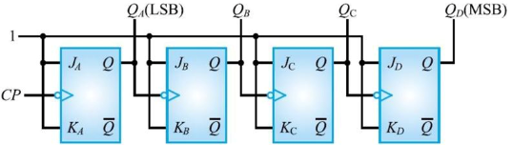
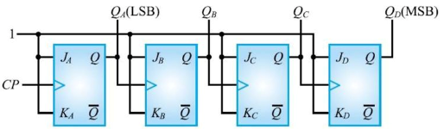
Binary Counter
Binary counter
입력되는 클럭의 개수를 세어서 2진수로 출력하는 카운터이다.
상향 카운터
하향 카운터

Slide 31
Binary Counter
input : clk, n_rst, down output : q_out[3:0]
source
testbench
assign q_out = q;
always @(posedge clk or negedge n_rst)
begin
if(!n_rst)
q <= 4'h0;
else if(down)
q <= q - 4'h1;
else
q <= q + 4'h1;
end
initial begin
clk = 1'b1;
n_rst = 1'b0;
end
always #(`T_CLK/2) clk = ~clk;
initial begin
down = 1'b0;
@(posedge clk);
n_rst = 1'b1;
down = 1'b0;
repeat(16) @(negedge clk);
down = 1'b1;
repeat(16) @(negedge clk);
$stop;
end

Slide 32
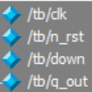
Binary Counter
wave

Slide 33
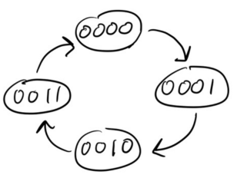
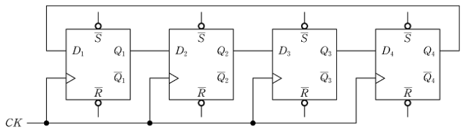
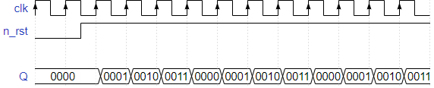
Ring Counter
Ring Counter
마지막 출력이 다시 처음 출력으로 들어가는 링 모양으로 구성된 카운터

Slide 34
Ring Counter
input : clk, n_rst output : q[3:0]
source
testbench
assign q = q_out;
always @(posedge clk or negedge n_rst) begin
if(!n_rst)
q_out <= 4'h0;
else if (q_out == 4'b0011)
q_out <= 4'h0;
else
q_out <= q_out + 4'h1;
end
initial begin
clk = 1'b1;
n_rst = 1'b0;
end
always #(`T_CLK/2) clk = ~clk;
initial begin
@(posedge clk);
n_rst = 1'b1;
repeat(16) @(negedge clk);
$stop;
end

Slide 35

Ring Counter
wave

Slide 36
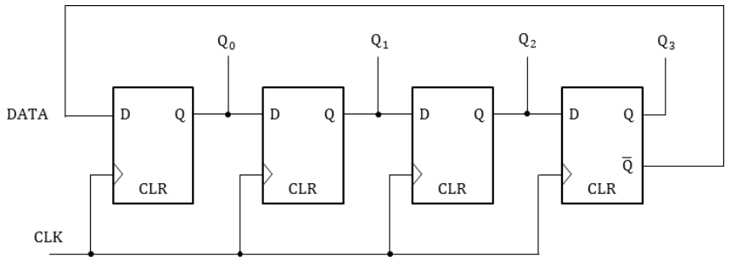
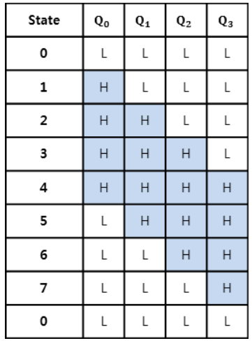
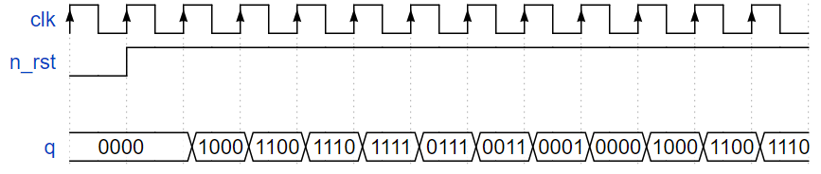
Johnson Counter
Johnson Counter
맨 마지막 FF의 출력중 NOT출력을 첫 번째 FF의 입력과 연결한 회로이다

Slide 37
Johnson Counter
input : clk, n_rst output : q[3:0]
source
testbench
always @(posedge clk or negedge n_rst) begin
if(!n_rst)
q_out <= 4'h0;
else if (q_out[0] == 1'b0)
begin
q_out <= {1’b1,q_out[3:1]};
end
else
begin
q_out <= {1’b0,q_out[3:1]};
end
end
initial begin
clk = 1'b1;
n_rst = 1'b0;
end
always #(`T_CLK/2) clk = ~clk;
initial begin
@(posedge clk)
n_rst = 1'b1;
#(`T_CLK*20)
$stop;
end

Slide 38

Johnson Counter
wave

Slide 39
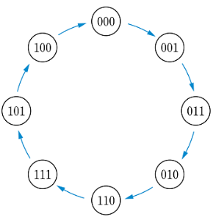
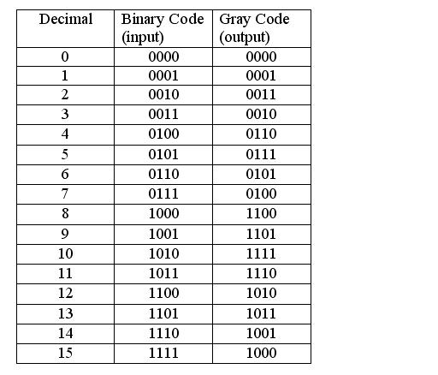
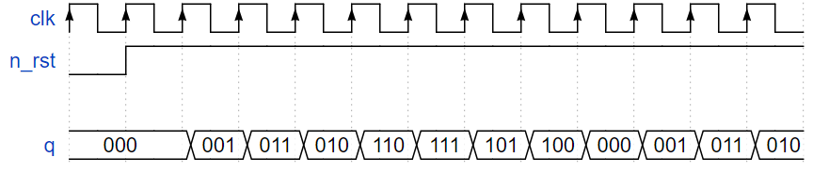
Gray Counter
Gray Counter
그레이 코드(이웃하는 숫자와 한비트만 다른 코드)를 카운터로 동작하게 만든것

Slide 40
Gray Counter
input : clk, n_rst output : q[2:0]
source
testbench
assign q = q_out;
always @(posedge clk or negedge n_rst) begin
if(!n_rst) begin
cnt <= 4'h0;
end
else begin
cnt <= (cnt==4'h7) ? 4'h0 : cnt + 1'b1;
end
end
always @(posedge clk or negedge n_rst) begin
if(!n_rst) begin
q_out <= 3'h0;
end
else begin
q_out[2] <= cnt[3]^cnt[2];
q_out[1] <= cnt[2]^cnt[1];
q_out[0] <= cnt[1]^cnt[0];
end
end
initial begin
clk = 1'b1;
n_rst = 1'b0;
end
always #(`T_CLK/2) clk = ~clk;
initial begin
@(posedge clk)
n_rst = 1'b1; #(`T_CLK*20) $stop;
end

Slide 41

Gray Counter
wave

Slide 42
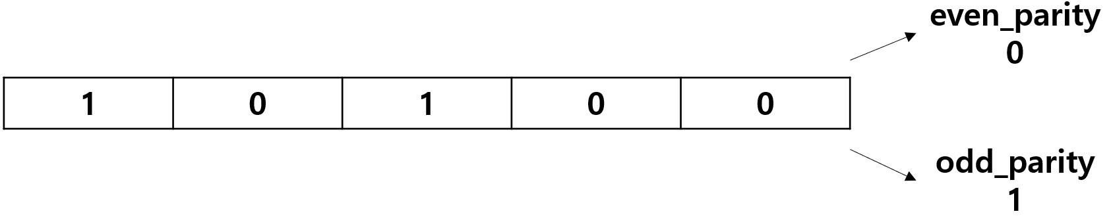
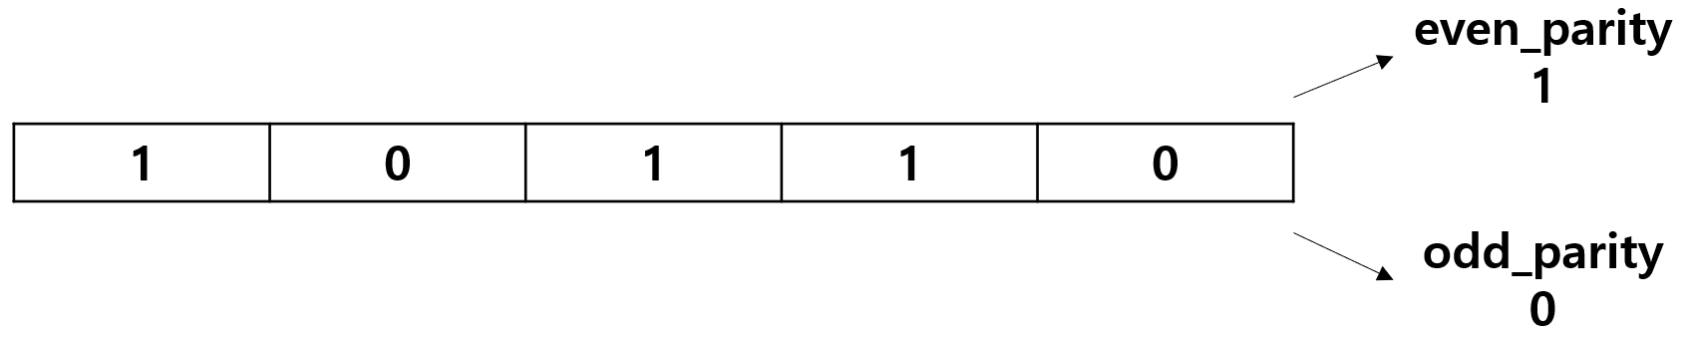
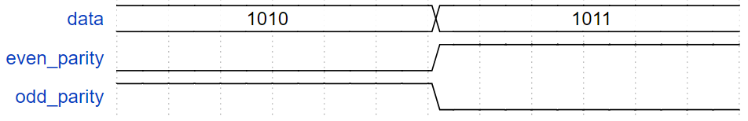
Parity Check
Parity Check
정보전달 과정에서 오류가 생겼는지를 확인하기위해 추가된 비트이다.

Slide 43
Parity Check
input : data[3:0] output : even_parity, odd_parity
source
testbench
always @(*)
begin
D[0] = data[0] ^ data[1];
D[1] = data[2] ^ data[3];
end
assign even_parity = D[0] ^ D[1];
assign odd_parity = ~(D[0] ^ D[1]);
initial begin
data = 4'b1010;
#2
data = 4'b1011;
#2
$stop;
end

Slide 44

Parity Check
wave

Slide 45
RCA(Ripple Carry Adder) 32bit
half_adder & full_adder
Full_adder
half_adder
module full_adder(
input a,
input b,
input c_in,
output s,
output c_out
);
wire s1;
wire c0;
wire c1;
half_adder u_half_adder1(
.a(a),
.b(b),
.s(s1),
.c_out(c0)
);
half_adder u_half_adder2(
.a(s1),
.b(c_in),
.s(s),
.c_out(c1)
);
assign c_out = c1 | c0;
module half_adder(
input a,
input b,
output s,
output c_out
);
assign s = a ^ b;
assign c_out = a & b;

Slide 46
RCA(Ripple Carry Adder) 32bit
RCA_4bit
rca_4bit
module rca_4bit(
input [3:0] a,
input [3:0] b,
input c_in,
output [3:0] s,
output c_out
);
wire c1;
wire c2;
wire c3;
full_adder u_full_adder1(
.a(a[0]),
.b(b[0]),
.c_in(c_in),
.s(s[0]),
.c_out(c1)
);
full_adder u_full_adder2(
.a(a[1]),
.b(b[1]),
.c_in(c1),
.s(s[1]),
.c_out(c2)
);
full_adder u_full_adder3(
.a(a[2]),
.b(b[2]),
.c_in(c2),
.s(s[2]),
.c_out(c3)
);
full_adder u_full_adder4(
.a(a[3]),
.b(b[3]),
.c_in(c3),
.s(s[3]),
.c_out(c_out)
);

Slide 47
RCA(Ripple Carry Adder) 32bit
RCA_8bit, RCA_16bit, RCA_32bit
8bit
16bit
32bit
wire c5;
rca_4bit u_rca_4bit1(
.a(a[3:0]),
.b(b[3:0]),
.c_in(c_in),
.s(s[3:0]),
.c_out(c5)
);
rca_4bit u_rca_4bit2(
.a(a[7:4]),
.b(b[7:4]),
.c_in(c5),
.s(s[7:4]),
.c_out(c_out)
);
wire c7;
rca_8bit u_rca_8bit1(
.a(a[7:0]),
.b(b[7:0]),
.c_in(c_in),
.s(s[7:0]),
.c_out(c7)
);
rca_8bit u_rca_8bit2(
.a(a[15:8]),
.b(b[15:8]),
.c_in(c7),
.s(s[15:8]),
.c_out(c_out)
);
wire c9;
rca_16bit u_rca_16bit(
.a(a[15:0]),
.b(b[15:0]),
.c_in(c_in),
.s(s[15:0]),
.c_out(c9)
);
rca_16bit u_rca_16bit2(
.a(a[31:16]),
.b(b[31:16]),
.c_in(c9),
.s(s[31:16]),
.c_out(c_out)
);

Slide 48
RCA(Ripple Carry Adder) 32bit
testbench
testbench
module tb();
reg [31:0] a;
reg [31:0] b;
reg c_in;
wire [31:0] s;
wire c_out;
rca_32bit u_rca_32bit(
.a(a),
.b(b),
.s(s),
.c_in(c_in),
.c_out(c_out)
);
initial begin
c_in = 1'h0;
a = 32'h4;
b = 32'h5;
#5
c_in = 1'h1;
a = 32'h4;
b = 32'h5;
#5
c_in = 1'h0;
a = 32'h6;
b = 32'h7;
#5
c_in = 1'h1;
a = 32'h6;
b = 32'h7;
#5
$stop;
end

Slide 49

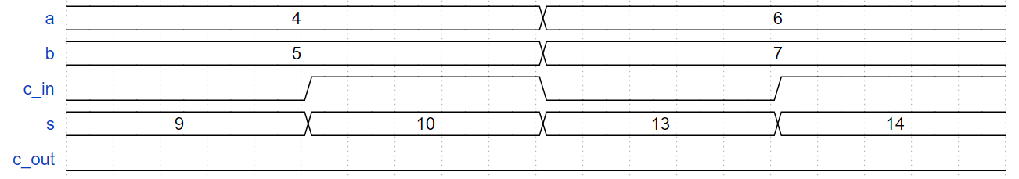
RCA(Ripple Carry Adder) 32bit
wave

Slide 50
CLA(Carry Look-Ahead) 32bit
input : a[3:0], b[3:0], c_in output : c_out, s[3:0]
source
testbench
assign p = a ^ g;
assign g = a & b;
assign c1 = g[0] | (p[0] & c_in);
assign c2 = g[1] | (p[1] & c1);
assign c3 = g[2] | (p[2] & c2);
assign c_out = g[3] | (p[3] & c3);
full_adder U_full_adder1(
.a(a[0]),
.b(b[0]),
.c_in(c_in),
.s(s[0]),
.c_out()
);
full_adder U_full_adder2(
.a(a[1]),
.b(b[1]),
.c_in(c1),
.s(s[1]),
.c_out()
);
full_adder U_full_adder3(
.a(a[2]),
.b(b[2]),
.c_in(c2),
.s(s[2]),
.c_out()
);
full_adder U_full_adder4(
.a(a[3]),
.b(b[3]),
.c_in(c3),
.s(s[3]),
.c_out()
);
initial begin
c_in = 1'h0;
a = 32'h5;
b = 32'h9;
#5
c_in = 1'h1;
a = 32'h5;
b = 32'h9;
#5
c_in = 1'h0;
a = 32'h6;
b = 32'h4;
#5
c_in = 1'h1;
a = 32'h6;
b = 32'h4;
#5
$stop;
end

Slide 51
CLA(Carry Look-Ahead) 32bit
CLA_8bit, 16bit, 32bit
8bit
16bit
32bit
cla_4bit u_cla_4bit_1(
.a(a[3:0]),
.b(b[3:0]),
.c_in(c_in),
.s(s[3:0]),
.c_out(c1)
);
cla_4bit u_cla_4bit_2(
.a(a[7:4]),
.b(b[7:4]),
.c_in(c1),
.s(s[7:4]),
.c_out(c_out)
);
cla_8bit u_cla_8bit_1(
.a(a[7:0]),
.b(b[7:0]),
.c_in(c_in),
.s(s[7:0]),
.c_out(c1)
);
cla_8bit u_cla_8bit_2(
.a(a[15:8]),
.b(b[15:8]),
.c_in(c1),
.s(s[15:8]),
.c_out(c_out)
);
cla_16bit u_cla_16bit_1(
.a(a[15:0]),
.b(b[15:0]),
.c_in(c_in),
.s(s[15:0]),
.c_out(c1)
);
cla_16bit u_cla_16bit_2(
.a(a[31:16]),
.b(b[31:16]),
.c_in(c1),
.s(s[31:16]),
.c_out(c_out)
);

Slide 52

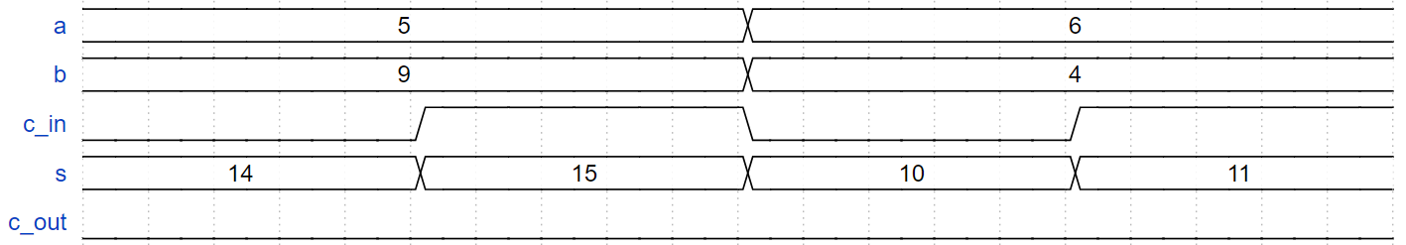
CLA(Carry Look-Ahead) 32bit
wave

Slide 53
Shift_add_multi
input : clk, n_rst, multiplier[3:0], multiplicand[3:0], start output : count[3:0], fin, product[7:0]
source
testbench
assign count = cnt;
always @(posedge clk or negedge n_rst) begin
if (!n_rst) begin
product <= 8'h0;
plier <= multiplier;
plicand <= multiplicand;
fin <= 1'b0;
cnt <= 4'b0;
end
else if (cnt == 4'h3) begin
fin <= 1'b1;
cnt <= 4'h0;
end
else if (start == 1'b1) begin
product <= (plier[0] == 1'b1)? (product + plicand) : product;
plicand <= plicand << 1;
plier <= plier >> 1;
cnt <= cnt + 4'b1;
end
else begin
product <= product;
plicand <= multiplicand;
plier <= multiplier;
cnt <= 4'b0;
end
end
initial begin
clk = 1'b1;
n_rst = 1'b0;
#7 n_rst = 1'b1;
end
always #(`T_CLK/2) clk = ~clk;
initial begin
start = 1'b0;
A = 4'h0; B = 4'h0;
#(`T_CLK)
A = 4'b0100; B = 4'b0011;
#2
start = 1'b1;
#(`T_CLK*2)
A = 4'b0010; B = 4'b0101;
#(`T_CLK*2)
A = 4'b0010; B = 4'b0010;
#(`T_CLK*5)
$stop;
end

Slide 54
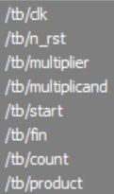
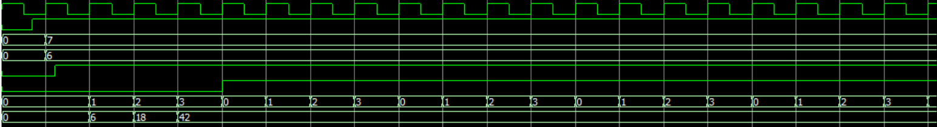

Shift_add_multi
wave

Slide 55
Substractions
input : clk, n_rst, A[3:0], B[3:0], start output : buho, sum[3:0]
source
testbench
always@(posedge clk or negedge n_rst)begin
if(!n_rst)begin
sum <= 4'b0;
buho <= 1'b0;
end
else if(A >= B)begin
sum <= (start == 1'b1)? A + (~B + 1'b1) : sum;
buho <= 1'b0;
end
else if (A < B)begin // -
sum <= (start == 1'b1)? ~(A + (~B + 1'b1))+1 : sum;
buho <= 1'b1;
end
else begin
buho <= 1'b0;
sum <= sum;
end
end
initial begin
clk = 1'b1;
n_rst = 1'b0;
#7 n_rst = 1'b1;
end
always #(`T_CLK/2) clk = ~clk;
initial begin
start = 1'b0;
A = 4'h0; B = 4'h0;
#(`T_CLK)
A = 4'b0100; B = 4'b0011;
#2
start = 1'b1;
#(`T_CLK*2)
A = 4'b0010; B = 4'b0101;
#(`T_CLK*2)
A = 4'b0010; B = 4'b0010;
#(`T_CLK*5)
$stop;
end

Slide 56



Substractions
wave

Slide 57
참고 자료
1) 한빛아카데미 IT CookBook, 디지털 논리회로/이론, 실습, 시뮬레이션
2) https://blog.naver.com/lagrange0115/220723457312
3) https://m.blog.naver.com/PostView.naver?isHttpsRedirect=true&blogId=lagrange0115&logNo=220729360287
4) https://m.blog.naver.com/leeyunghuk1/220990704042
5) https://blog.naver.com/PostView.naver?blogId=beaqon&logNo=221253750901

Slide 58
발표를 마치겠습니다.
감사합니다.

